Slide 1
OFSTED ‘DEEP DIVE’ MUSIC INSPECTIONS
Preparation, information and support
for Herefordshire Primary Schools
led by Sue Nicholls – independent music education consultant

Slide 2
INTENT IMPLEMENTATION IMPACT
These are the keywords for the new Ofsted Inspection Framework and will be used to frame conversations between teachers and inspectors.
Remember that inspectors won’t approach the task in an identical way so I can’t offer you a finite template!

Slide 3
The evidence so far…
Evidence gathered from Deep Dive music inspections in several primary schools.
What were inspectors asking/looking for?
Examples of questions available on the Encore Enterprises website
https://www.encore-enterprises.com/ofsted-deep-dive

Slide 4
1. Training to support ‘Deep Dive’ inspections
What is your rationale for teaching music in the curriculum?
Entitlement?
Enculturation?
An aesthetic essential?
Sustains well-being?
To instil a life-long love of music?
A unique ‘subject’ without which life would be impoverished?
A conduit for self-expression?
Cultural capital?
An immersive and compelling artform?........

Slide 5
2. Training to support ‘Deep Dive’ inspections
NATIONAL CURRICULUM PROGRAMME OF STUDY
The highlighted aims often featured as key questions during inspections
Aims: to ensure that all pupils:
perform, listen to, review and evaluate music across a range of historical periods, genres, styles and traditions, including the works of the great composers and musicians.
learn to sing and to use their voices
to create and compose music on their own and with others
have the opportunity to learn a musical instrument
use technology appropriately
have the opportunity to progress to the next level of musical excellence.
understand and explore how music is created, produced and communicated, including through the inter-related dimensions: pitch, duration, dynamics, tempo, timbre, texture and appropriate musical notations.

Slide 6
3. Training to support ‘Deep Dive’ inspections
What is the recommended length and frequency of music lessons in primary schools?
Most educators share the opinion that lessons should be taught weekly for:
KS1: 30 minutes
KS2: 45 - 60 minutes
‘Carousel’ arrangements are not ideal for music

Slide 7
4. Training to support ‘Deep Dive’ inspections
Is the school’s music scheme fit for purpose?
Charanga/ Music Express cover all NC requirements
Re Music Express: Collins have developed new ‘skills’ documents: available freely to all
Curriculum maps for each year group (Y1-6)
Summary of skills for each year group (Y1-6)
Table of skills progression across the year groups
2-year rolling programme for mixed-age classes
https://collins.co.uk/pages/primary-music-music-express-skills-progression-and-curriculum-mapping
A FREE scheme ‘MUSIC MADE SIMPLE’ is available on the Encore Enterprises website
https://www.encore-enterprises.com/ofsted-deep-dive
*** Check that the music content offered in other curriculum frameworks fully covers NC requirements

Slide 8
5. Training to support ‘Deep Dive’ inspections
Are teachers, TAs or other musicians teaching music in EYFS and primary settings, adequately skilled and confident to
Audits for subject leaders and generalist colleagues are available on the Encore Enterprises website – very useful for establishing confidence levels and training needs!
Training offers:
Annual School Music Conference and CPD courses
Charanga training
Music Express training is available from Collins (naomi.cook@harpercollins.co.uk)
CME (Certificate for Music Educators awarded by Trinity and ABRSM) is a recognised national qualification available at centres nationwide: many centres offer distance learning programmes.

Slide 9
6. Training to support ‘Deep Dive’ inspections
Is long, medium and short term planning in place?
Charanga and Music Express both provide detailed planning at each level.
*** Check other curriculum frameworks for adequate music planning

Slide 10
7. Training to support ‘Deep Dive’ inspections
Is there a year-on-year Action Plan with clear success criteria?
Music Action Plan formats will vary from school to school but they should set out achievable aims that support the development of music across the school and reflect practitioners’ and pupils’ needs.
(Action Plan example is available on the Encore Enterprises website) https://www.encore-enterprises.com/ofsted-deep-dive

Slide 11
8. Training to support ‘Deep Dive’ inspections
Does the school follow a clear progression route for music, citing skills, knowledge and experience that all pupils will acquire on their musical ‘journey’?
‘Minimum Expected Standards’ - a very useful document, is freely available on the website and offers a clear progression map for music, EYFS – KS2
Charanga & Music Express provide progressive and age-appropriate musical content in all units of work.
*** Check that other curriculum frameworks provide musical progression

Slide 12
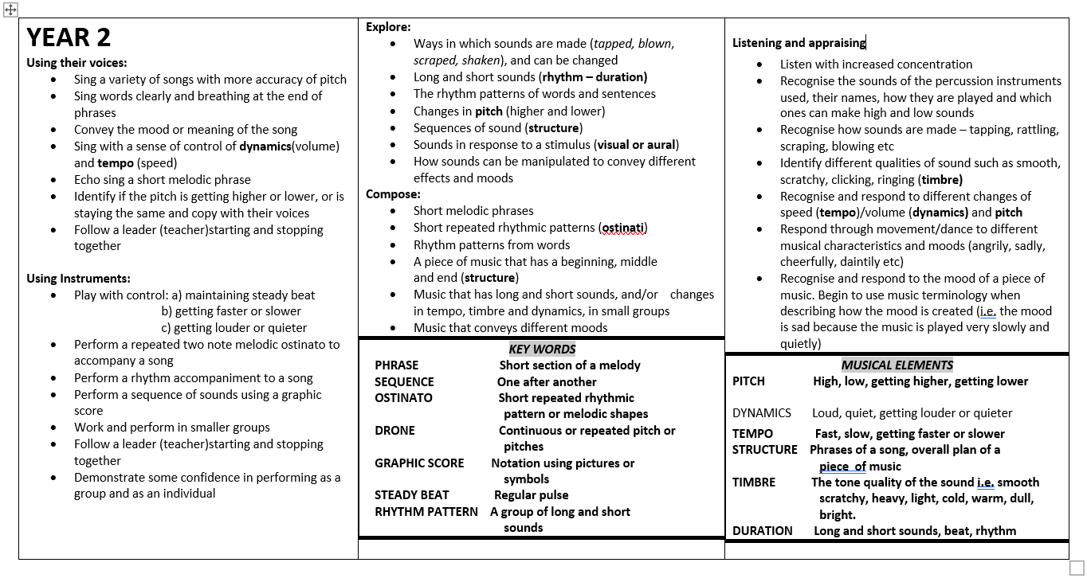

Slide 13
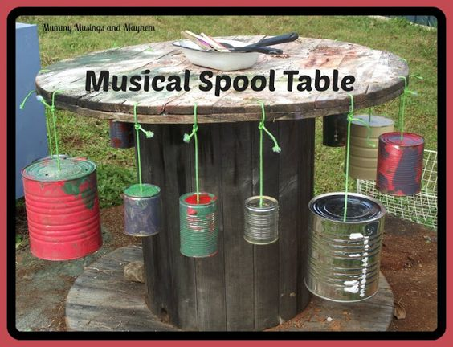
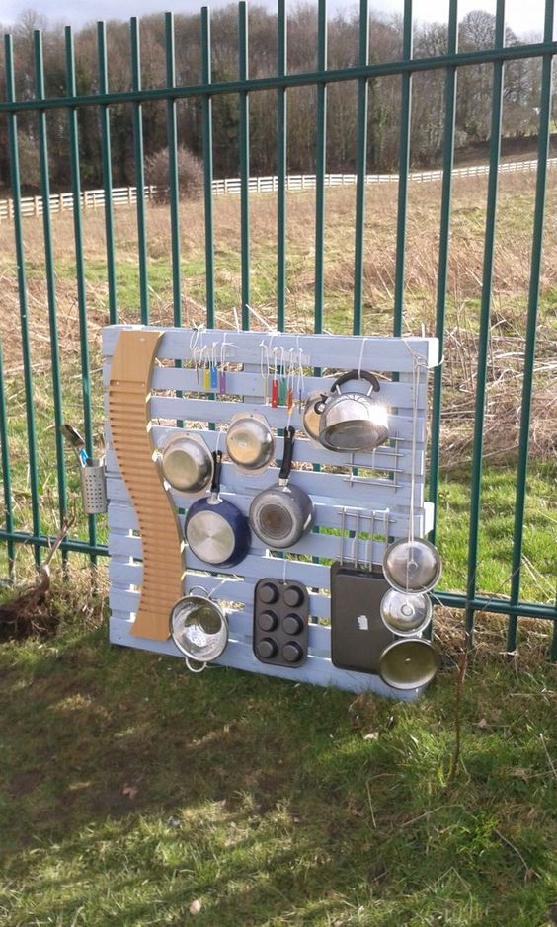
9. Training to support ‘Deep Dive’ inspections
Is EYFS music delivered through best holistic practice?
Does EYFS outdoor provision offer an enabling environment appropriate to young learners’ musical exploration?
Music in EYFS settings should be happening every day in informal, child-initiated as well as teacher-led approaches.
Useful document ‘EYFS Musical Development Matters’
https://www.early-education.org.uk/musical-development-matters-download

Slide 14
10. Training to support ‘Deep Dive’ inspections
How is the quality of music provision monitored?
Planning submitted to subject leader
Short video clips (two per half term), ideally filmed during the first and final lessons of a unit of work and uploaded to class folders on the school server.
‘Drop-in’ lesson observations to monitor the quality of curriculum provision and also ‘Wider Opportunities’ lessons (whole class instrumental teaching). Lesson observations led by subject leader perhaps joined by SLT. Consider inviting the school governor responsible for music to attend?
Ofsted document: ‘Music in Schools, promoting good practice’ supporting Heads and Governors on best approaches to lesson observation (available on the Encore Enterprises website)

Slide 15
11. Training to support ‘Deep Dive’ inspections
How are SEND pupils accommodated in music lessons?
Ideally, music scheme lesson plans should be printed and then annotated to show how pupils with specific needs are accommodated.
If not possible for every lesson, then for each unit (examples are found on the website).

Slide 16
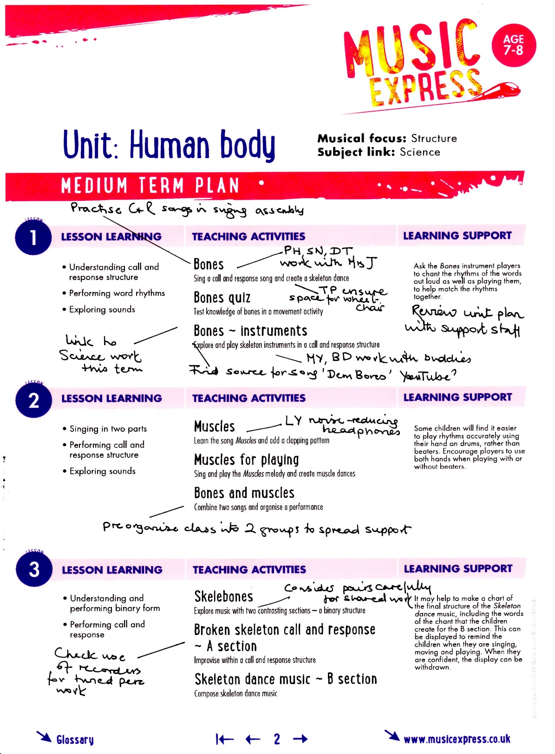

Slide 17
12. Training to support ‘Deep Dive’ inspections
How is delivery differentiated in mixed age classes?
Charanga: differentiated tasks: Gold, Silver, Bronze
Music Express:
same unit titles for adjacent year groups
‘skills analysis’ documents identify learning objectives
2-year rolling programme for mixed age groups
https://collins.co.uk/pages/primary-music-music-express-skills-progression-and-curriculum-mapping

Slide 18
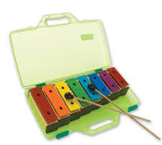
13. Training to support ‘Deep Dive’ inspections
Is percussion provision adequate and stored appropriately?
Percussion trolleys are often placed in awkward spaces/cupboards with instruments crammed on inaccessible shelves.
Better to divide up percussion between Y1/2, 3/4, 5/6 and keep in large plastic boxes in classrooms with a ‘chart’ of instrument contents with photos & names.
Check that sufficient tuned percussion is available. Six sets of chime bars sold in plastic cases are cheaper than one wooden xylophone (£179)

Slide 20
14. Training to support ‘Deep Dive’ inspections
Do classes sing every day/week?
Are there opportunities for each KS to sing together?
Is repertoire appropriate – does it demonstrate progression?
Encourage staff to sing with pupils every day: singing underpins well-being, releases endorphins, promotes listening & social interaction.
Impossible to cover appropriate repertoire/progression for Reception-Y6 in whole school singing assemblies: consider separate Key Stage singing led fortnightly.
‘Sing Up’ - over 750 songs; a menu for different age groups, topics, musical styles etc; recordings, backing/echo tracks, teaching notes and song-based units of work.
Music Express and Charanga also have Song Banks
A vocal progression document from ‘Minimum Expected Standards’ is available on the Encore Enterprises website
A staff choir is a wonderful endorsement of the value of singing!!!

Slide 21
15. Training to support ‘Deep Dive’ inspections
Is technology threaded appropriately through music delivery?
Explore apps that connect technology to practical ‘live’ music-making and reduce whiteboard-centric lessons.
Mark Sanderson: Computing Consultant: Herefordshire Computing Support msanderson@herefordshire.gov.uk
Chris Smith: Apple c.smith@krcs.co.uk leads workshops.
Ben Sellers: virtual iPad training available for individual settings or (much cheaper) all Hub partner schools
https://transformancemusic.org/product/teach-music-with-ipads-virtual-cpd-day/

Slide 22
16. Training to support ‘Deep Dive’ inspections
Are pupils engaged in regular and creative music-making – do they identify as ‘musicians’ and ‘composers’?
Generalist teachers often lack confidence in teaching the composing/improvising component of NC music.
Pupils should be given regular opportunities to create their own music, beginning with exploration at EYFS and developing towards greater competence through experimentation and knowledge of the interrelated dimensions. Composition should incorporate voices, percussion, ‘Wider Opportunities’ instruments and technology… but not all at once!!!!!
Music Express/Charanga offer ample scope for creative outcomes but opportunities for pupils’ music-making should not be bypassed!
A document showing progression of the NC composing strand is found on the website.

Slide 23
17. Training to support ‘Deep Dive’ inspections
Which classes have ‘Wider Opportunities’? (whole class instrumental tuition)
How is progress monitored? Is there dialogue between tutor and attending class teacher /TA?
A useful dialogue document is available on the website for Y3,4,5 and 6, offering a record and overview of achievement at the end of each unit.

Slide 24
18. Training to support ‘Deep Dive’ inspections
How are ‘Wider Opportunities’ classes’ achievements incorporated into the life of the school? e.g. assembly performances, showcase opportunities. Is there ‘continuation’ after participation?
Maximise exposure of pupils’ instrumental playing… more than just the end of term ‘showcase’. Take video clips, photographs and keep a record of in-school performances.
Encourage pupils who show aptitude or whose well-being needs are being addressed by additional tuition, to continue.

Slide 25
19. Training to support ‘Deep Dive’ inspections
1: Is there any additional instrumental tuition for individual pupils/small groups? Funded by parents, covered by the school/ PP? How are players integrated into the musical life of the school?
2: Be aware of and keep a record of pupils who learn instruments privately outside school or who sing in community/faith choirs/groups?
Use the dialogue documents (slide 17) to record achievements of those in additional tuition groups and make efforts to include these players, AND those who acquire musical skills independently outside school, in in-school performances.

Slide 26
20. Training to support ‘Deep Dive’ inspections
Which music activities go beyond National Curriculum requirements i.e. enrichment?
Are these organised by Encore or ‘private enterprise’ e.g.
• Projects with Arts organisations
• Live music events provided by Encore
• Combined school festivals or cluster events
• In-house performances/shows to parents
• Encore recital team visits – ‘Music on the Move’
Emphasis on genuine legacy, not ‘one-off’ tokenistic experiences.

Slide 27
21. Training to support ‘Deep Dive’ inspections
How do you instil a love of music and acquaintance with a broad range of music?
Carefully selected listening music (music schemes will integrate a range of examples), but also consider ‘enrichment’ i.e a programme of music played in assemblies. Provide appropriate background information for context e.g. PowerPoint slides showing featured instruments, a few facts and any relevant ‘elements’….
Music leader might consider supporting the assembly leader with some brief information ‘pointers’ to share with pupils.
(NC: Listen to music from historical periods, genres, styles and traditions, including the works of the great composers and musicians; an understanding of the history of music)
BBC Ten Pieces
ABRSM Classical 100

Slide 28
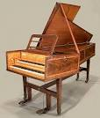
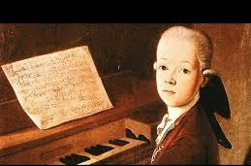
This week we are listening to:
‘Ah! Vous dirai-je, Maman’ by Mozart
He composed 12 variations based on the tune,
‘Twinkle Twinkle little star’ played on a harpsichord.
Each new piece has extra twiddly bits!

Slide 29
22. Training to support ‘Deep Dive’ inspections
Are lunchtime or out-of-hours music activities offered at your school? Are they truly inclusive? i.e. do members come from ‘identified groups’ e.g. SEND, Pupil Premium, FSM, EAL …boys etc.
Maintain and check registers of attending pupils and be proactive and creative in organising clubs and activities that appeal to ‘hard-to-reach’ pupils.
Some pupils may be unable to attend after school so lunchtime may be a better option.

Slide 30
23. Training to support ‘Deep Dive’ inspections
Which Encore events are regularly attended?
How are links with the Encore maintained?
Be informed of events, attend meetings/training and maintain links using Encore social media platforms e.g. Facebook /Instagram/Twitter
Like us on Facebook: www.facebook.com/encorehereford
Follow us on Twitter: www.twitter.com/encorehereford
Check out our Instagram Page: www.instagram.com/encorehereford
See some of our work on our YouTube Channel: https://www.youtube.com

Slide 31
24. Training to support ‘Deep Dive’ inspections
Do musical performances form a regular part of school life?
Performances are crucial because they ….
Make a statement that music is ‘important’
Create an ambassadorial function; schools are more ‘visible’
Forge valuable links with community and parents
Increase pupils’ self confidence, self-assurance and well-being
Provides important social contact
Adds to your school’s ‘cultural capital’

Slide 32
25. Training to support ‘Deep Dive’ inspections
How does music feature in cross-curricular or topic-based planning? Is music selected for its ‘topic’ content age-appropriate, does it maintains progression of skills, knowledge and understanding?
The danger of incorporating random cross-curricular material is that content is inappropriately matched to pupils’ musical experience:
The ‘Minimum Expected Standards’ document works as a ‘check-list’ of age-appropriate content
‘Music Express’ scheme is topic-based

Slide 33
26. Training to support ‘Deep Dive’ inspections
How do key skills and knowledge contribute to the acquisition of ‘cultural capital’ (preparing pupils to take advantage of opportunities in future life) particularly for pupils from disadvantaged backgrounds?
‘Cultural capital’ will be assured if, alongside other strong arts provision, your school offers rich, varied, high quality creative musical experiences for pupils.
Consider also ‘ArtsMark’ and ‘Arts Award’

Slide 34
27. Training to support ‘Deep Dive’ inspections
How is pupil progress measured, monitored and recorded in practical and manageable ways? Do older pupils self-assess showing independent development of musical skills and competences? e.g. polar graphs?
‘Formal music assessment in primary music should be as hands off and as light touch as possible.’ Keith Swanwick
Commercial schemes offer assessment formats
A free, flexible three-tier assessment framework document is available on the website and based on ‘Minimum Expected Standards’
Class folders for uploading footage of music-making –e.g. at the beginning and end of each unit, on school servers
Include any tangible evidence e.g. photographs, graphic scores, screen-grabs

Slide 35
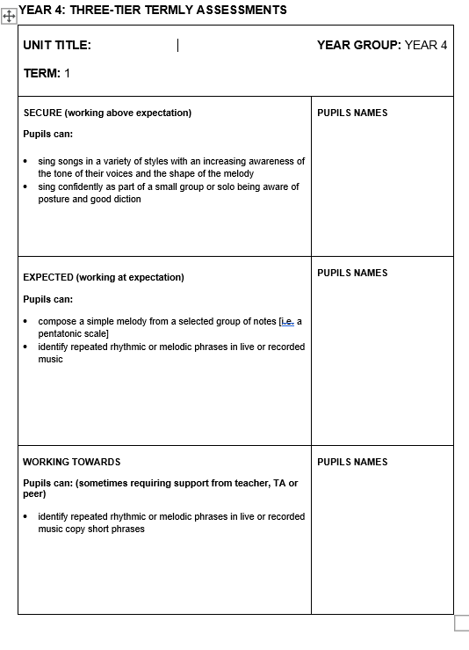

Slide 36
28. Training to support ‘Deep Dive’ inspections
Polar self-assessment graph - pupils and teachers co-select musical criteria for the 8 segments and colour in to match perceived competence
0 = poor; 10 = perfection!!!

Slide 37
29. Training to support ‘Deep Dive’ inspections
What information should be kept in music subject leader’s file?
Suggested headings – the fine detail is available on the website
Section 1: OVERVIEW: MUSIC YEAR ON YEAR
Section 2: MUSIC IN THE MEDIUM TERM
Section 3: AUDITS AND QUESTIONNAIRES -links to action plans
Section 4: DAY-TO-DAY IMPLEMENTATION
Section 5: PUPILS’ MUSIC MAKING
Section 6: CPD and TRAINING
Section 7: CELEBRATION OF MUSIC
Section 8: APPENDIX e.g. reports from HMI, Ofsted etc.

Slide 38
30. Training to support ‘Deep Dive’ inspections
Final thoughts … and support routes offered by Encore
Social Media platforms: Facebook; Twitter; Instagram; YouTube
Arts Award
‘Wider Opportunities’ projects
School support visits
CPD opportunities
Singing strategy support
Subsidised Charanga subscription and Charanga training
Sue Nicholls suelnicholls@hotmail.com

